Slide 1
GoogLeNet - Inception

Slide 2
GoogLeNet - Inception
A deep convolutional neural network architecture named as Inception, which was responsible for setting the new state of the art for classification and detection in the ImageNet Large-Scale Visual Recognition Challenge 2014 (ILSVRC14).
The main assurance of this architecture is the improved utilization of the computing resources inside the network.
This was achieved by a carefully crafted design that allows for increasing the depth and width of the network while keeping the computational budget constant.
To optimize quality, the architectural decisions were based on the Hebbian principle and the intuition of multi-scale
The network is called GoogLeNet, a 22 layers deep network, the quality of which is assessed in the context of classification and detection.

Slide 3
Motivation to GooLeNet
GoogLeNet submission to ILSVRC 2014 actually uses 12 fewer parameters than the winning architecture of Krizhevsky while being significantly more accurate.
The biggest gains in object-detection have come from the synergy of deep architectures and classical computer vision, like the R-CNN algorithm by Girshick.
In this focus on an efficient deep neural network architecture for computer vision, codenamed Inception.
In this case, the word “deep” is used in two different meanings: first of all, in the sense that we introduce a new level of organization in the form of the “Inception module” and in the more direct sense of increased network depth.

Slide 4
Research Motivation of Inception Model
With the ongoing traction of mobile and embedded computing, the efficiency of our algorithms – especially their power and memory use – gains importance.
It is noteworthy that the considerations leading to the design of the deep architecture presented in this Deep Network included this factor rather than having a complete fixation on accuracy numbers.
For most of the experiments, the models were designed to keep a computational budget of 1:5 billion multiply-adds at inference time, so that the they do not end up to be a purely academic curiosity, but could be put to real world use, even on large datasets, at a reasonable cost.

Slide 5
Motivation and High Level Considerations
The most straightforward way of improving the performance of deep neural networks is by increasing their size. This includes both increasing the depth – the number of levels – of the network and its width: the number of units at each level. This is as an easy and safe way of training higher quality models, especially given the availability of a large amount of labeled training data. However this simple solution comes with two major drawbacks.
Bigger size typically means a larger number of parameters, which makes the enlarged network more prone to overfitting, especially if the number of labeled examples in the training set is limited.
This can become a major bottleneck, since the creation of high quality training sets can be tricky and expensive, especially if expert human raters are necessary to distinguish between fine-grained visual categories like those in ImageNet (even in the 1000-class ILSVRC subset)
Another drawback of uniformly increased network size is the dramatically increased use of computational resources. For example, in a deep vision network, if two convolutional layers are chained, any uniform increase in the number of their filters results in a quadratic increase of computation. If the added capacity is used inefficiently (for example, if most weights end up to be close to zero), then a lot of computation is wasted.
Since in practice the computational budget is always finite, an efficient distribution of computing resources is preferred to an indiscriminate increase of size, even when the main objective is to increase the quality of results.

Slide 6
Architectural Details
The main idea of the Inception architecture is based on finding out how an optimal local sparse structure in a convolutional vision network can be approximated and covered by readily available dense components.
Inception architecture are restricted to filter sizes 1×1, 3×3 and 5×5, however this decision was based more on convenience rather than necessity.
It also means that the suggested architecture is a combination of all those layers with their output filter banks concatenated into a single output vector forming the input of the next stage.
Additionally, since pooling operations have been essential for the success in current state of the art convolutional networks, it suggests that adding an alternative parallel pooling path in each such stage should have additional beneficial effect, too

Slide 7
As these “Inception modules” are stacked on top of each other, their output correlation statistics are bound to vary:
As features of higher abstraction are captured by higher layers, their spatial concentration is expected to decrease suggesting that the ratio of 3*3 and 5*5 convolutions should increase as we move to higher layers.

Slide 8
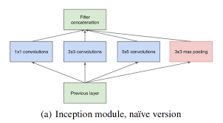
1st Inception V1

Slide 9
Why different size filter
As there is change in location of object .
Different filters of multiple size on same level, so that we can capture every kind of information.
As sometime information is smaller or bigger in position so to capture this use different size filter.
Network is wider in place of deeper.

Slide 10
One big problem with the above modules, at least in this na¨ıve form, is that even a modest number of 5*5 convolutions can be prohibitively expensive on top of a convolutional layer with a large number of filters.
This problem becomes even more pronounced once pooling units are added to the mix:their number of output filters equals to the number of filters in the previous stage.
The merging of the output of the pooling layer with the outputs of convolutional layers would lead to an inevitable increase in the number of outputs from stage to stage.
Even while this architecture might cover the optimal sparse structure, it would do it very inefficiently, leading to a computational blow up within a few stages.

Slide 11
This leads to the second idea of the proposed architecture: judiciously applying dimension reductions and projections wherever the computational requirements would increase too much otherwise.
We would like to keep our representation sparse at most places and compress the signals only whenever they have to be aggregated masse.
That is, 1*1 convolutions are used to compute reductions before the expensive 3*3 and 5*5 convolutions.
Besides being used as reductions, they also include the use of rectified linear activation which makes them dual-purpose.

Slide 12
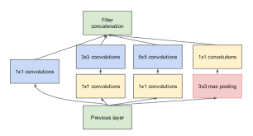
2nd Module of Inception V1 Dimension Reduction.

Slide 13
2nd Module of Inception V1, Dimension Reduction
Less parameters means less computational resources.
We are adding extra 1*1 Convolution , so that we can limit the no.of Channel .
This is to reduce dimensions .

Slide 14
Filter size of 3*3 on grayscale image = 3*3*1
Filter size of 3*3 on RGB image = 3*3*3
If convolution layer and has depth of 24 = 3*3*24

Slide 16
InceptionV3

Slide 17
1. Factorization into Smaller Convolution

Slide 21
InceptionV3 Layer Architecture
48-layer network Trained on Image Net dataset for 1000 classes

Slide 25
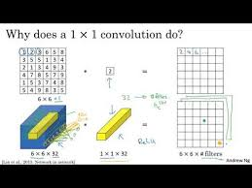
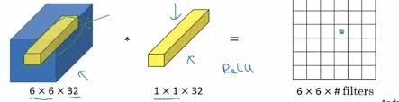
1× 1 CNN

Slide 26
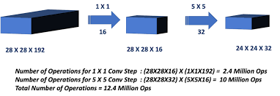

Slide 27
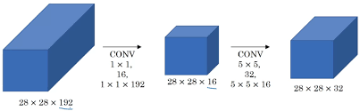

Slide 28
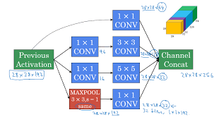

Slide 29
As these “Inception modules” are stacked on top of each other, their output correlation statistics are bound to vary: as features of higher abstraction are captured by higher layers, their spatial concentration is expected to decrease suggesting that the ratio of 3×3 and 5×5 convolutions should increase as move to higher layers.
Inception network is a network consisting of modules of the above type stacked upon each other, with occasional max-pooling layers with stride 2 to halve the resolution of the grid.
For technical reasons (memory efficiency during training), it seemed beneficial to start using Inception modules only at higher layers while keeping the lower layers in traditional convolutional fashion.

Slide 30
Computational Complexity
One of the main beneficial aspects of this architecture is that it allows for increasing the number of units at each stage significantly without an uncontrolled blow-up in computational complexity.
The ubiquitous use of dimension reduction allows for shielding the large number of input filters of the last stage to the next layer, first reducing their dimension before convolving over them with a large patch size. Another practically useful aspect of this design is that it aligns with the intuition that visual information should be processed at various scales and then aggregated so that the next stage can abstract features from different scales simultaneously.
The improved use of computational resources allows for increasing both the width of each stage as well as the number of stages without getting into computational difficulties.

Slide 31
GoogLeNet
GoogLeNet as team-name in the ILSVRC14 competition.
Use GoogLeNet to refer to the particular incarnation of the Inception architecture used in submission for the competition.
Used a deeper and wider Inception network, the quality of which was slightly inferior, but adding it to the ensemble seemed to improve the results marginally.
It was found that a move from fully connected layers to average pooling improved the top-1 accuracy by about 0.6%, however the use of dropout remained essential even after removing the fully connected layers.

Slide 32
Design
All the convolutions, including those inside the Inception modules, use rectified linear activation.
The size of the receptive field in our network is 224*224 taking RGB color channels with mean subtraction. “#3*3 reduce” and “#5*5 reduce” stands for the number of 1*1 filters in the reduction layer used before the 3*3 and 5*5 convolutions.
The network was designed with computational efficiency and practicality in mind, so that inference can be run on individual devices including even those with limited computational resources, especially with low-memory footprint.
The network is 22 layers deep when counting only layers with parameters (or 27 layers if we also count pooling). The overall number of layers (independent building blocks) used for the construction of the network is about 100.
The use of average pooling before the classifier is differs in that we use an extra linear layer. This enables adapting and fine-tuning networks for other label sets easily.
It was found that a move from fully connected layers to average pooling improved the top-1 accuracy by about 0.6%, however the use of dropout remained essential even after removing the fully connected layers.

Slide 33
exact structure of the extra network
An average pooling layer with 5*5 filter size and stride 3, resulting in an 4*4*512 output for the (4a), and 44528 for the (4d) stage.
A 11 convolution with 128 filters for dimension reduction and rectified linear activation.
A fully connected layer with 1024 units and rectified linear activation.
A dropout layer with 70% ratio of dropped outputs.
A linear layer with softmax loss as the classifier

Slide 34
Given the relatively large depth of the network, the ability to propagate gradients back through all the
layers in an effective manner was a concern. One interesting insight is that the strong performance
of relatively shallower networks on this task suggests that the features produced by the layers in the
middle of the network should be very discriminative. By adding auxiliary classifiers connected to
these intermediate layers, we would expect to encourage discrimination in the lower stages in the
classifier, increase the gradient signal that gets propagated back, and provide additional regularization.
These classifiers take the form of smaller convolutional networks put on top of the output of
the Inception (4a) and (4d) modules. During training, their loss gets added to the total loss of the
network with a discount weight (the losses of the auxiliary classifiers were weighted by 0.3). At
inference time, these auxiliary networks are discarded.

Slide 35
Advantages
Results appear to yield a solid evidence that approximating the expected optimal sparse structure by readily available dense building blocks is a feasible method for improving neural networks for computer vision.
The main advantage of this method is a significant quality gain at a modest increase of computational requirements compared to shallower and less wide networks.
Also note that detection work was competitive despite of neither utilizing context nor performing bounding box regression and this fact provides further evidence of the strength of the Inception architecture.

Slide 36
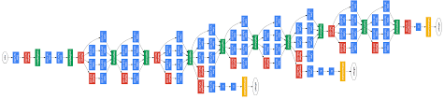

Slide 38
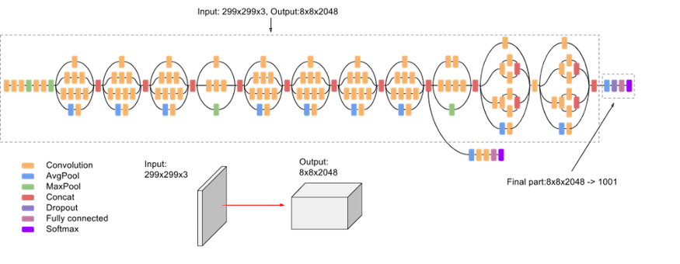
Inception

Slide 39
Inception v3 is a widely-used image recognition model that has been shown to attain greater than 78.1% accuracy on the ImageNet dataset. The model is the combination of many ideas developed by multiple researchers over the years.
The model itself is made up of symmetric and asymmetric building blocks, including convolutions, average pooling, max pooling, dropouts, and fully connected layers. Batch norm is used extensively throughout the model and applied to activation inputs. Loss is computed via Softmax.
Inception work with Factorizing Convolutions used to reduce number of connections and parameters to learn.
This will increase the speed and gives good performance.

Slide 40
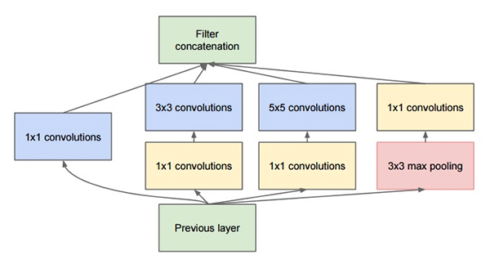
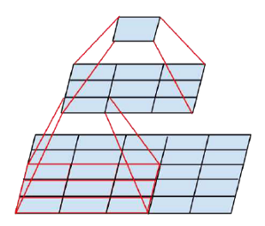
Inception V3
The “Inception” micro-architecture was first introduced by Szegedy et al. in their 2014 paper, Going Deeper with Convolutions:
The original Inception module used in GoogLeNet.

Slide 41
GoogleNet used a 5x5 convolution layer whereas in inception work with two 3x3 layers to reduce the number of learning parameters. In 5 x 5 has 25 total parameters were 3 x 3 + 3 x 3 has total 18 parameters to learn. So significantly no learning parameter is reduced by 28%.
Factorization Into Asymmetric Convolutions is also used in Inception which also helps to help to reduce the learning parameter.
One 3×1 convolution followed by one 1×3 convolution replaces one 3×3. In one 3 x 3 has a total of 9 parameter whereas, 3 x 1 + 1 x 3 has a total of 6 parameters so it will reduce by 33%.
With 42 layers deep, the computation cost is only about 2.5 higher than that of GoogleNet and much more efficient than that of VGGNet.

Slide 42
Inception V3
The goal of the inception module is to act as a “multi-level feature extractor” by computing 1×1, 3×3, and 5×5 convolutions within the same module of the network
The output of these filters are then stacked along the channel dimension and before being fed into the next layer in the network.
The original incarnation of this architecture was called GoogLeNet, but subsequent manifestations have simply been called Inception vN where N refers to the version number put out by Google.
The Inception V3 architecture included in the Keras core comes from the later publication by Szegedy et al., Rethinking the Inception Architecture for Computer Vision (2015) which proposes updates to the inception module to further boost ImageNet classification accuracy.
The weights for Inception V3 are smaller than both VGG and ResNet, coming in at 96MB.

Slide 43
Inception-v3 with 144 crops and 4 models ensembled,
the top-5 error rate of 3.58% is obtained,
and finally obtained 1st Runner Up (image classification) in ILSVRC 2015.

Slide 44
Inception Net
Issue: Kernal Size
Deciding on a fixed kernel size is rather difficult.
Larger kernels are preferred for more global features that are distributed over large area of the image
On the other hand smaller kernels provide good results in detecting area specific features that are distributed across the image frame.
For effective recognition of such variable sized feature, we need kernels of different sizes. That is what Inception does.
Inception V1,V2,V3,V4
Paper: Christian Szeged, Going deeper with convolutions, IEEE CVPR, Int Conf, 7-12 June 2015, USA (https://arxiv.org/pdf/1409.4842.pdf)

Slide 45


Slide 46
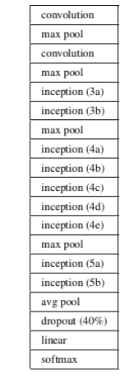

Slide 47
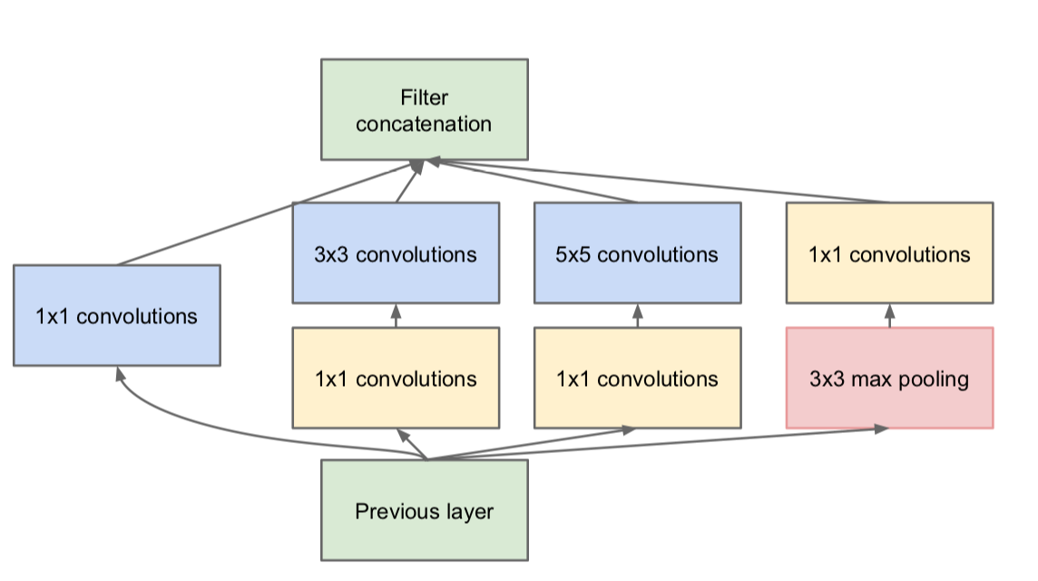
Each inception module consists of four operations in parallel 1x1 conv layer 3x3 conv layer 5x5 conv layer max pooling

Slide 48
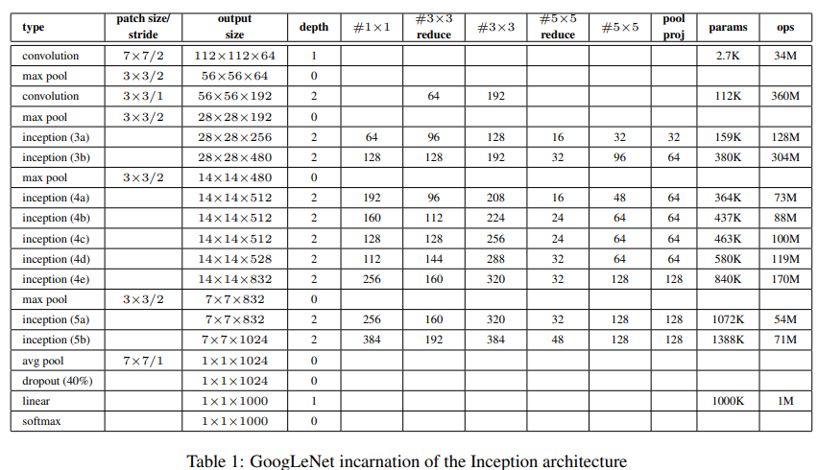

Slide 49
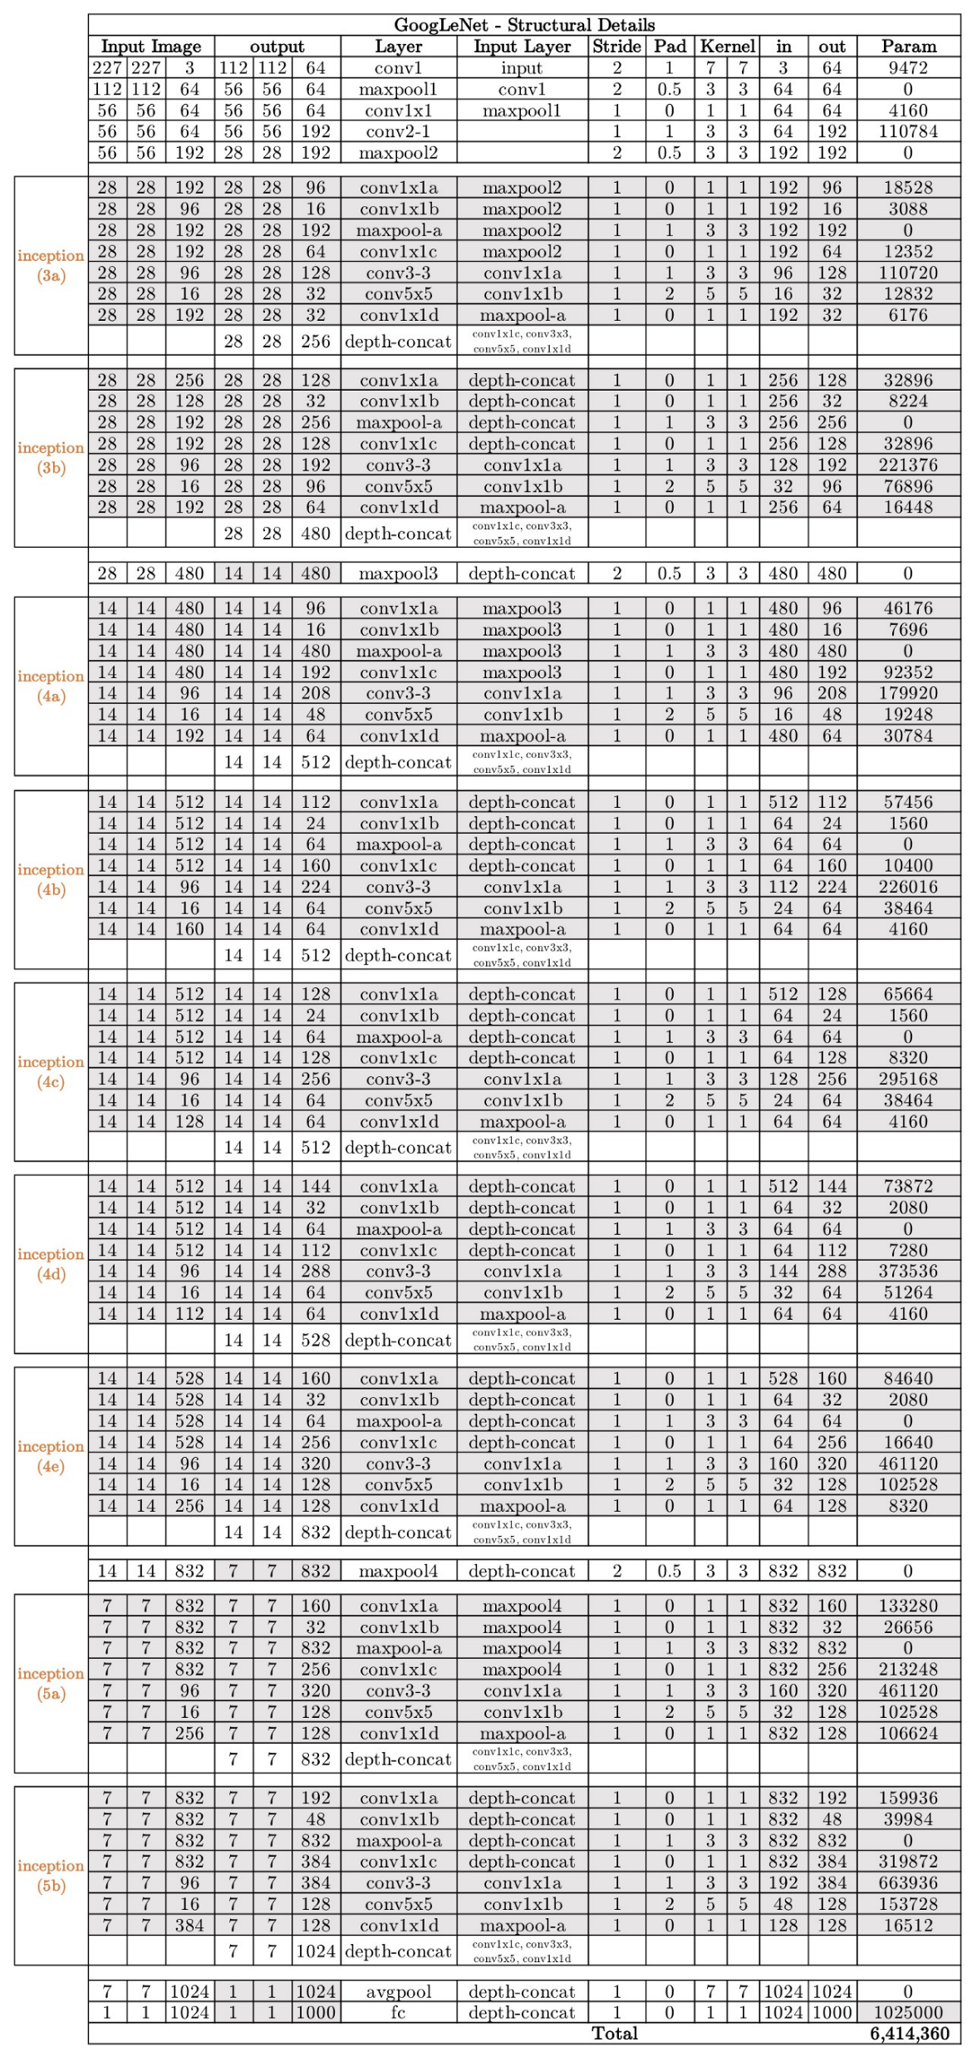
There are multiple version of Inception, the most simplest one being the GoogLeNet.

Slide 50


Slide 54
GoogLeNet network with all the bells and whistles…
Page 7 of the paper

Slide 55
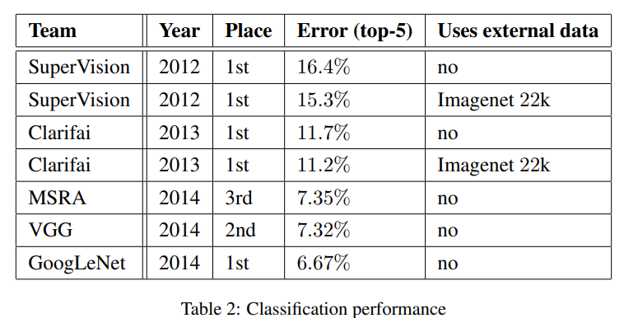

Slide 56
Beauty on InceptionNet
Inception increases the network space from which the best network is to be chosen via training.
Each inception module is able to capture salient features at different levels. Global features are captured by the 5x5 conv layer, while the 3x3 conv layer is prone to capturing distributed features.
The max-pooling operation is responsible of capturing low level features that standout in a neighborhood. At a given level, all of these features are extracted and concatenated before it is fed to next layer.
We leave for the network/training to decide what features hold the most values and weight accordingly.

Slide 57
Competitive Analysis

Slide 58
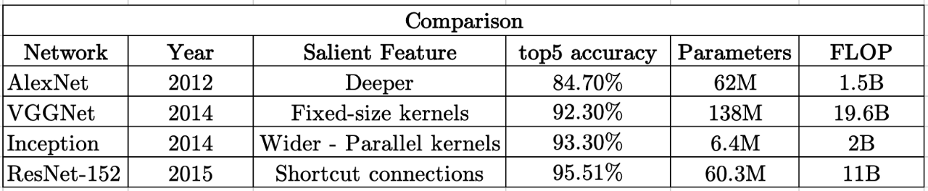
Summary and Competitive Analysis
FLOP: Floating Point Operations (FLOP)
A number of comparisons can be drawn:
AlexNet and ResNet-152, both have about 60M parameters but there is about 10% difference in their top-5 accuracy. But training a ResNet-152 requires a lot of computations (about 10 times more than that of AlexNet) which means more more training time and energy required.
VGGNet not only has a higher number of parameters and FLOP as compared to ResNet-152, but also has a decreased accuracy. It takes more time to train a VGGNet with a reduced accuracy.
Training an AlexNet takes about the same time as training Inception. The memory requirements is 10 times less with an improved accuracy (about 9%)

Slide 59
Practical using ResNet

Slide 60
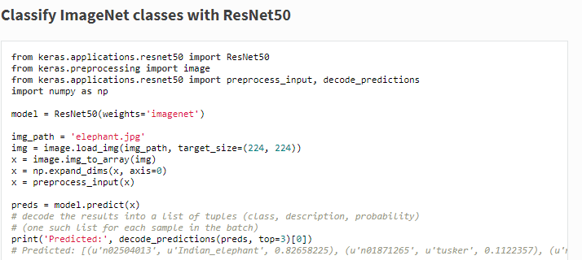
Classify ImageNet classes with ResNet50

Slide 61
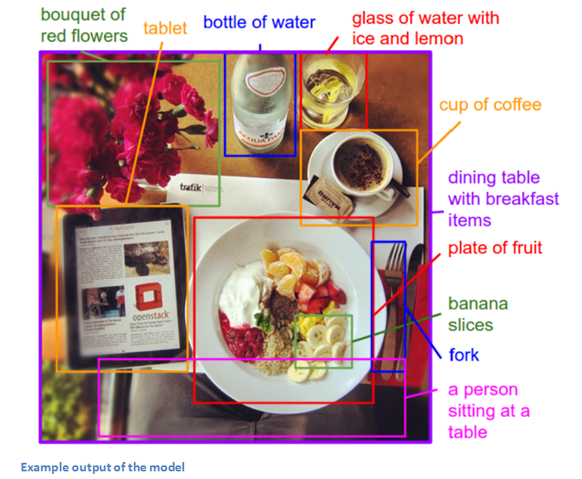
Generating Image Descriptions

Slide 62
Limitations of Transfer Learning
One of the biggest limitations to transfer learning is the problem of negative transfer.
Similar Data…. Over fitting while training
You can not remove layers with confidence to reduce the number of parameters.
You use it as a black box….

Slide 63
DenseNet
DenseNet is composed of Dense blocks as shown below. Within those blocks, the layers are densely connected together: Each layer gets the input from previous layers output feature maps. This extreme reuse of residuals creates deep supervision because every layer receives more supervision from the previous layer and thus loss function will react accordingly and due to this methodology, it makes it a more powerful network.

Slide 64
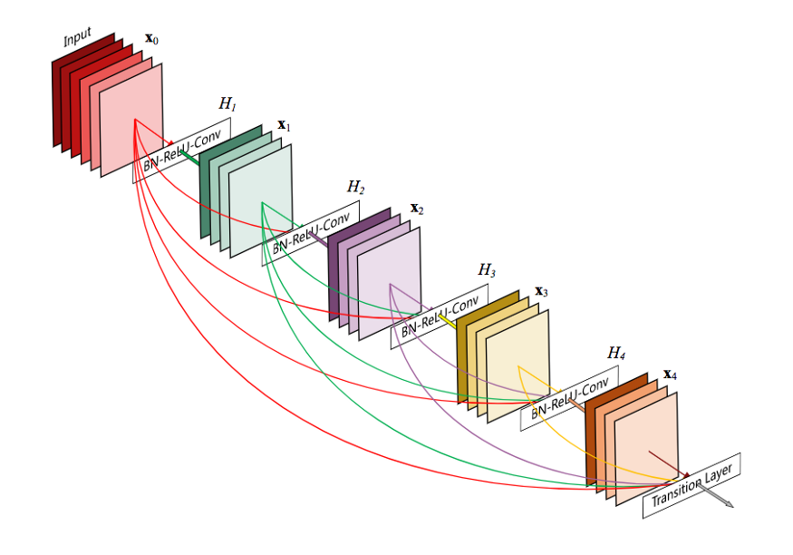
Block Diagram of DenseNet

Slide 65
DenseNet consists of 2 blocks:
Dense block: A single block consists of these layers:
Batch Normalization
ReLU Activation
3x3 Convolution
2. Transition layer: In ResNet sum of residual will be performed, instead of summing residual Densenet concatenates all the feature maps. This layer is made of
Batch Normalization
1x1 Convolution
Average Pooling

Slide 66
Basically, Densenet’s convolution generates less number of feature maps.
DenseNet has a lower need for wide layers because as layers are densely connected there is little redundancy in the learned features.
Layers of dense block share a piece of collective knowledge.
The number of output feature maps of a layer is defined as the growth rate.
Eventually, the growth rate controls how much new information each layer contributes to the globally.

Slide 67
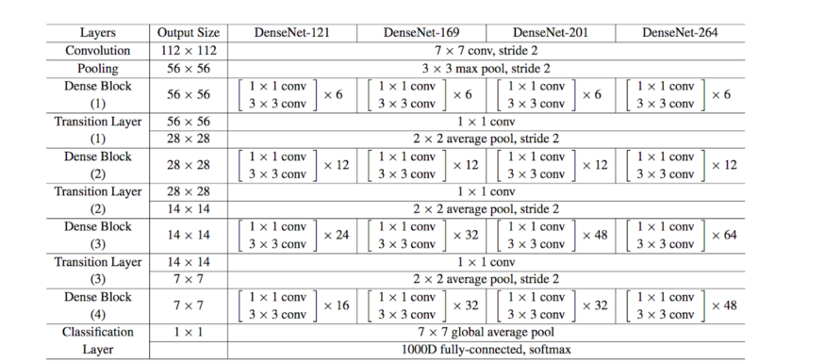
DenseNet Architecture

Slide 68
DenseNet
In a nutshell, the DenseNet architecture uses the residual mechanism to its maximum by making every layer densely connected to its subsequent layers.
Model’s compactness makes the learned features non-redundant as they are all shared through a collective knowledge.
To train deep networks that are densely connected because of implicit deep supervision where the gradient is flowing back more easily due to short connections.

Slide 69
https://www.youtube.com/watch?v=p047WxBf-qA

